Slide 1

Basic Details of the Team and Problem Statement
Ministry/Organization Name/Student Innovation:
PS Code: 1489
Problem Statement Title: STUDENT INNOVATION
Team Name: BYTEME
Team Leader Name: ANUSHA GUPTA
Institute Code (AISHE): U-0939
Institute Name: SISTER NIVEDITA UNIVERSITY
Theme Name: TRANSPORTATION & LOGISTICS

Slide 2
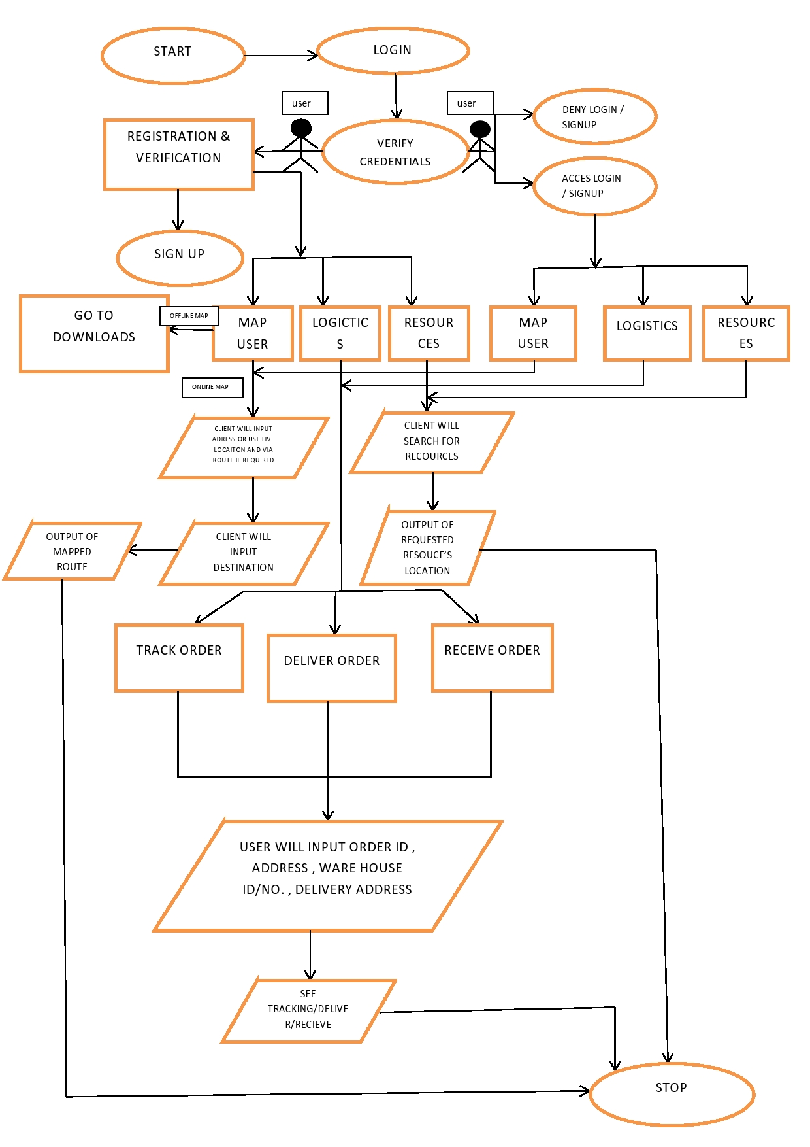
Idea/Approach Details
FLOWCHART
Describe your idea/Solution/Prototype here:
Maps are the most commonly used product in the market with extensive use but our app aims to solve these drawbacks like
Limited offline access
Incorrect and outdated info
Battery drain
Traffic data reliability.
Our app will, solve these drawbacks by providing
Offline map feature
Real-time traffic data
Simplified mode
Region-specific maps for local areas
which gives a productive experience to the user, thereby covering the common drawbacks.
Describe your Technology stack here:
Python
MongoDB
TensorFlow
HTML, CSS, JS
AWS
Numpy
Pandas
Librosa

Slide 3
Idea/Approach Details
Describe your Use Cases here
Describe your Dependencies / Show stopper here
Showing location
Generate a route
Navigate
Show resources
Logistics details
Weather forecast
Via-route (a route from origin to destination via some place selected by user)
Tourist spots
Offline maps
Parking spots
Safety alerts
Locations of public washrooms
Traffic Management – Can increase traffic in certain areas by rerouting.
Emergency Services – Reliance on these apps may strain these services.
Data Usage – Includes need for robust cellular networks.
Digital Divide – Reliance on widespread access to smartphones.

Slide 4
Team Member Details
Team Leader Name: ANUSHA GUPTA
Branch (Btech) Stream (CSE) Year (I)
Team Member 1 Name: KRITTIKA DEY
Branch (Btech) Stream (CSE) Year (I)
Team Member 2 Name: SNEHA DAS
Branch (Btech) Stream (CSE) Year (I)
Team Member 3 Name: RITWIKA NAG
Branch (Btech) Stream (CSE) Year (I)
Team Member 4 Name: ANKAN PATRA
Branch (Btech) Stream (CSE) Year (I)
Team Member 5 Name: SOURASISH GHOSH
Branch (Btech) Stream (CSE) Year (I)
Team Mentor 1 Name: NIL
Category (Academic/Industry): Expertise (AI/ML/Blockchain etc): Domain Experience (in years):
Team Mentor 2 Name: NIL
Category (Academic/Industry): Expertise (AI/ML/Blockchain etc): Domain Experience (in years):

